Slide 1
Storytelling with Data
Designing a Predictive Machine Learning Framework for Healthcare System Integrity
Core Project: Operational Analytics & Anomaly Detection

Slide 2
Agenda
Introduction
Objective
Methodology
Analysis
Conclusion and Recommendations
QA

Slide 3
Introduction
About me
Najat El Ouafi
Currently a stay-at-home mom
Bachelor Degree in Biology and Master Degree in Ecology
Work experience : Sales Trainer
Medical Devices
Cosmetics Products
Currently living in Virginia

Slide 4
Objective
Explores a multi-facility healthcare dataset to map how chronic care patients transition through various stages of clinical operations.
By identifying structural inconsistencies and high-risk patient groups during the exploratory phase, we can establish baseline metrics needed to predict and reduce readmission

Slide 5
Methodology & Tools
The Data Footprint: An enterprise-level clinical dataset detailing care patterns across an integrated medical delivery network.
Dataset Dimensions:101,766 unique patient encounter records (Rows).
Dataset Dimensionality: 50 distinct clinical and administrative tracking variables (Columns).

Slide 6
Technical Methodology & Tools
Microsoft Excel: Initial screening and manual spelling validation of specialty lists and Data Mapping
Python: (Pandas) Standardizing corrupted age strings and handling missing data values.
SQL Back-end data aggregation, filtering and categorical grouping.
Tableau Building interactive Business Intelligence dashboards

Slide 7

Analysis

Slide 8
Age Demographics vs. Care Continuity
The demographic data suggests that age is a stronger predictor of readmission volume than gender until age 80.
Future modeling should specifically investigate why the 70-80 age group has a higher propensity for return visits compared to younger cohorts with similar clinical profiles.

Slide 9
Age Demographics vs. Care Continuity
Caucasian patients comprise the vast majority of the dataset with 76,099 encounters nearly four times the volume of the next largest group, African American patients
Risk: If left uncorrected, automated fraud models or care-tracking systems will over-optimize for this majority group while missing critical patterns unique to minority patient populations.

Slide 10
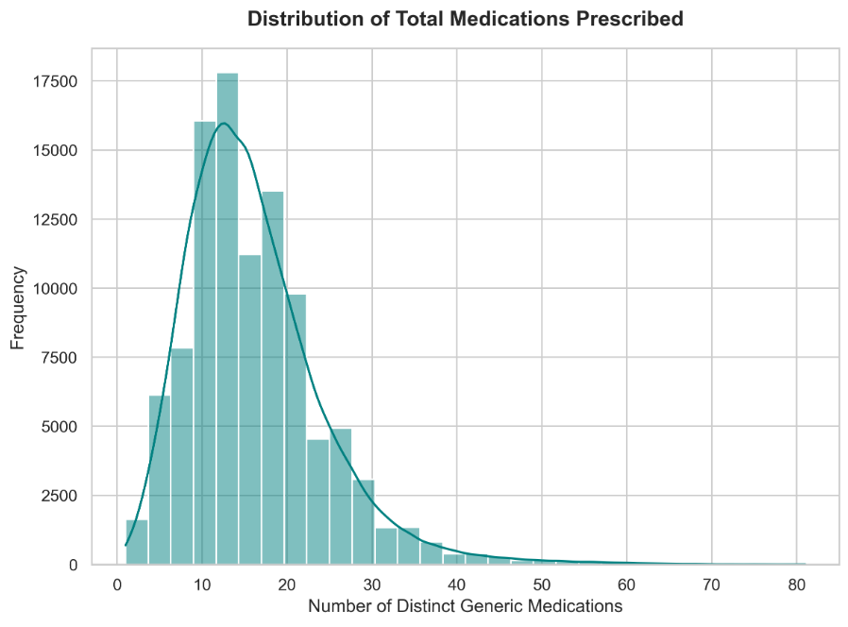
The Medication Burden & Treatment Changes
The data reveals an intense medication burden.
While the average patient is prescribed around 15 drugs, the chart shows an extreme tail stretching up to 80+ distinct medications for a single visit

Slide 11
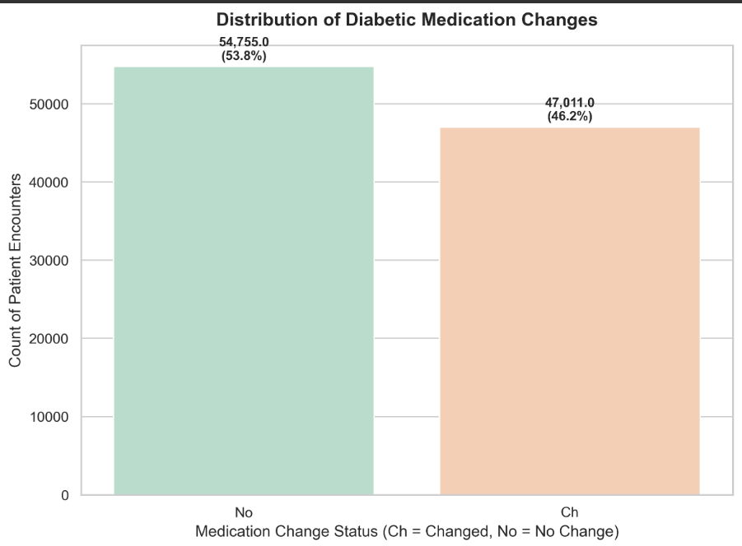
The Medication Burden & Treatment Changes
High Therapeutic Volatility: Over 47% of all patients have their critical medications actively changed or adjusted during their stay.
When a patient is sent home with a massive list of drugs that were just modified, their risk of confusion or non-adherence spikes dramatically.

Slide 12
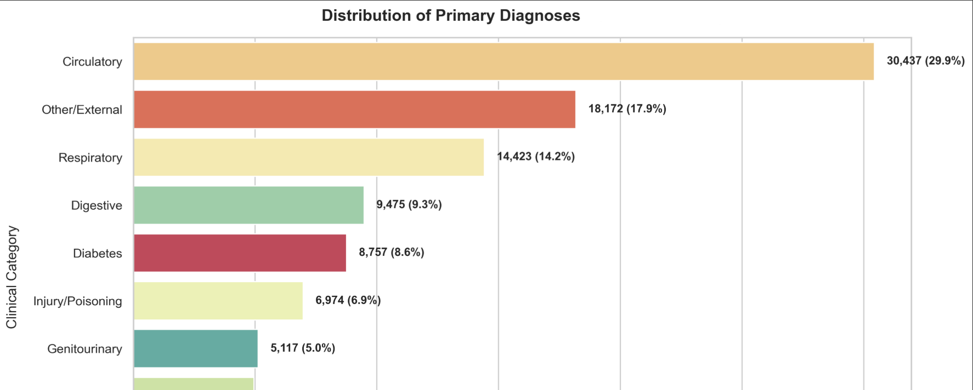
Primary Diagnoses
Circulatory diseases (heart failure, severe hypertension) dominate the hospital, accounting for 30.4% of admissions. True primary diabetes encounters make up only 8.7%.

Slide 13
Admission Distribution
The Emergency Gate: Over 53% of all patients enter the hospital directly through the Emergency Room. Because emergency entries happen quickly and bypass standard insurance pre-approvals, they represent the main area where resource leaks

Slide 14
Findings and Conclusion
The Emergency Room Bottleneck: More than half of all patients enter through the emergency pipeline. This lack of pre-scheduled coordination puts immense pressure on hospital resources and limits up-front administrative checks.
The Medication Safety Gap: Nearly half of all patients experience sudden medication changes right before discharge, creating a clear operational gap where errors can happen once the patient leaves the facility
Heart Conditions Lead the Way: Even though this is a chronic diabetic dataset, cardiorespiratory emergencies drive the vast majority of hospitalizations. Care programs must look at the whole patient, not just their blood sugar.

Slide 15
Strategic Recommendations
Create a Medication Safety Net: Assign dedicated clinical pharmacists to do an immediate follow-up review for the 47% of patients discharged with active medication changes ('Ch').
01
Clean Out Administrative Noise: Filter out deceased or hospice entries from risk-tracking datasets so they don't accidentally skew active operational charts.
02
Build Targeted Safety Nets for Seniors: Focus transitional care resources on the high-volume 60–80 age bracket, since they face the highest complexity and readmission rates.
03

